Slide 1
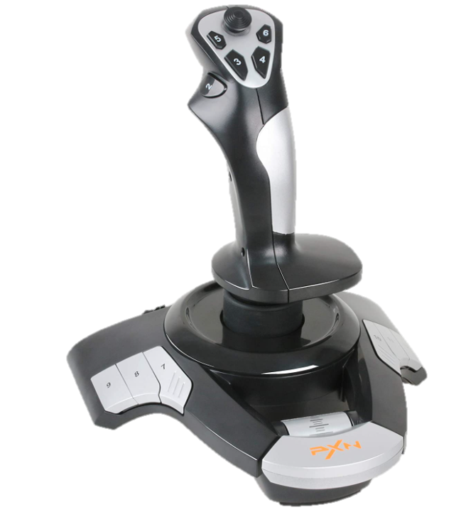
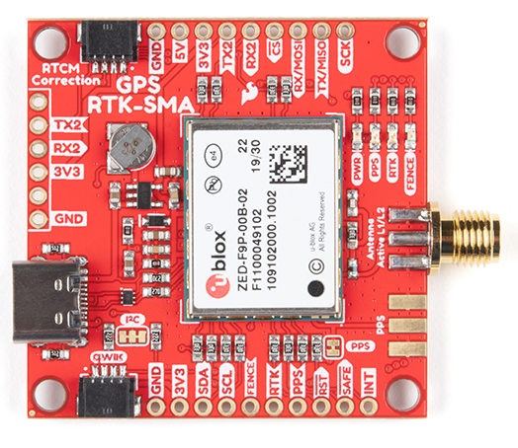
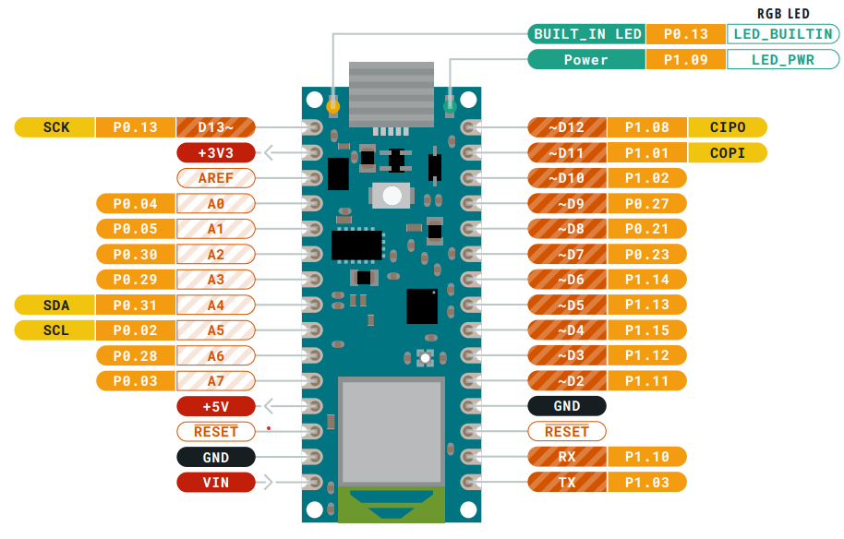

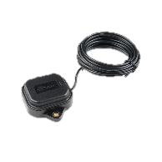
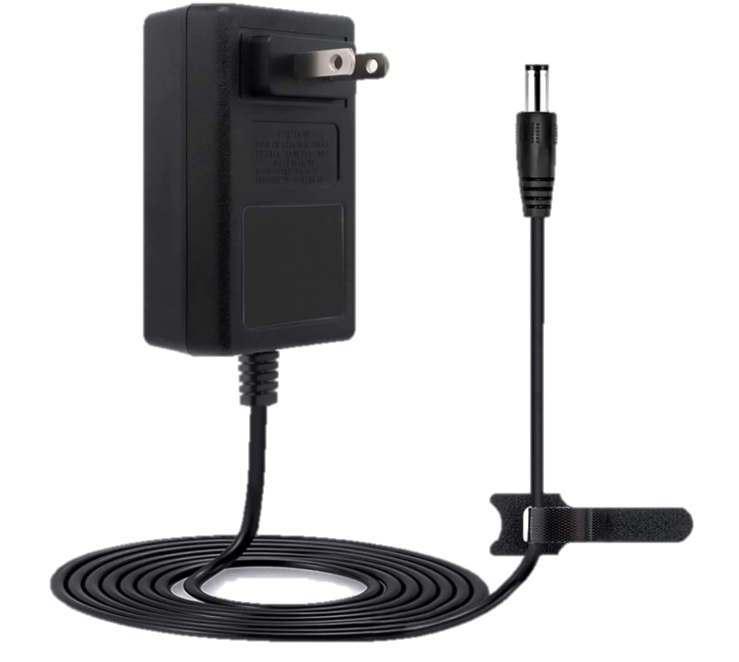
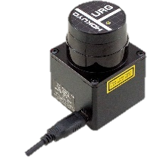
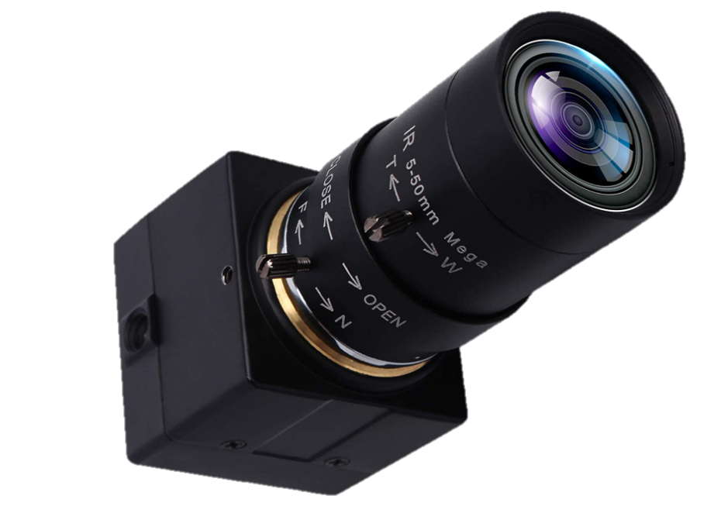
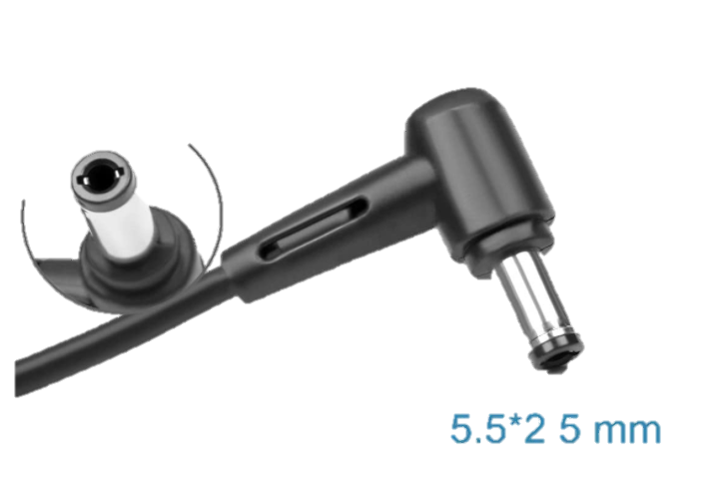
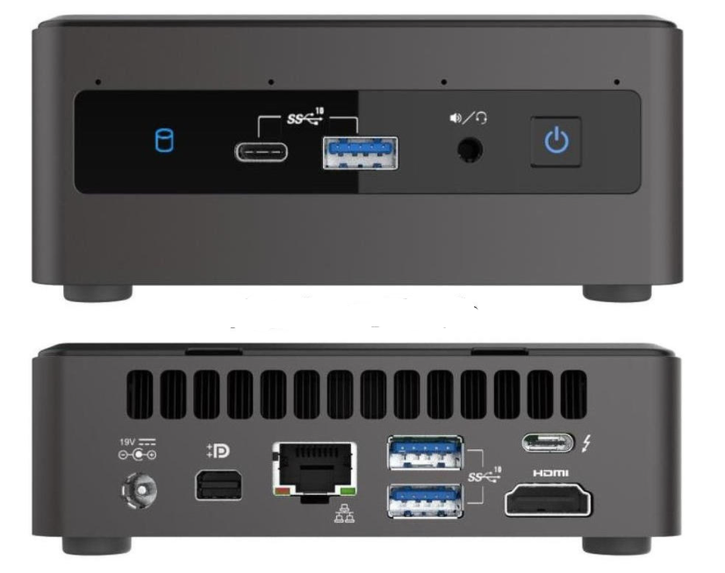
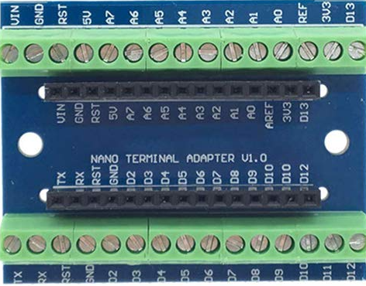
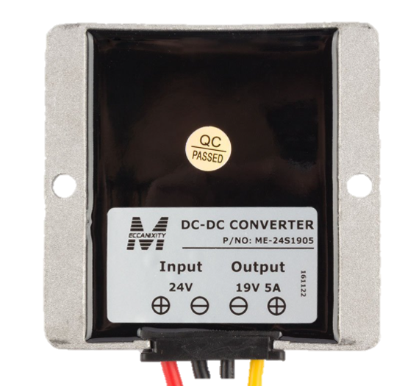
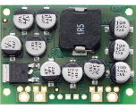
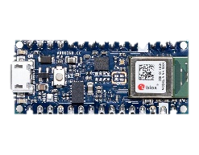
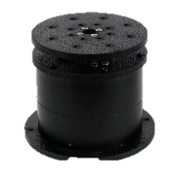
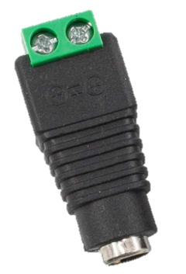
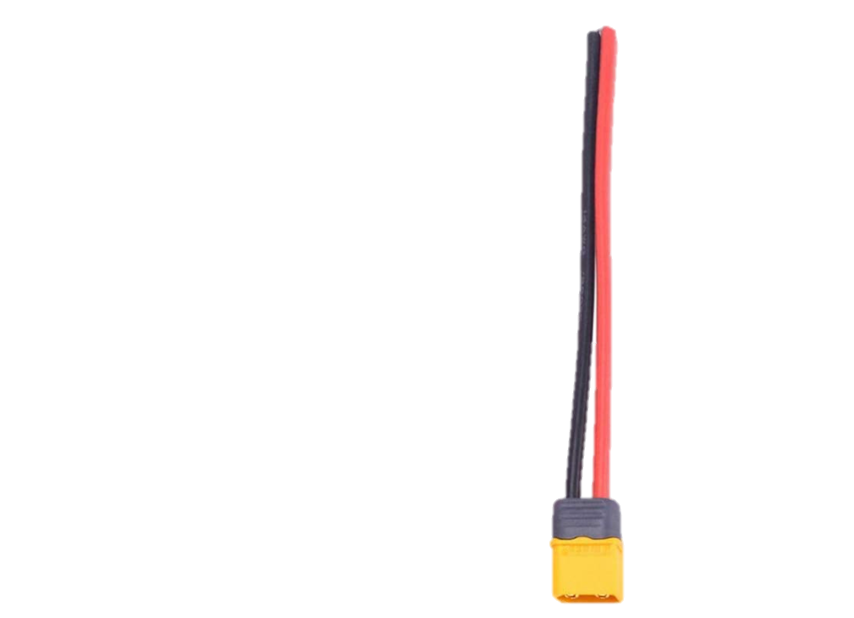
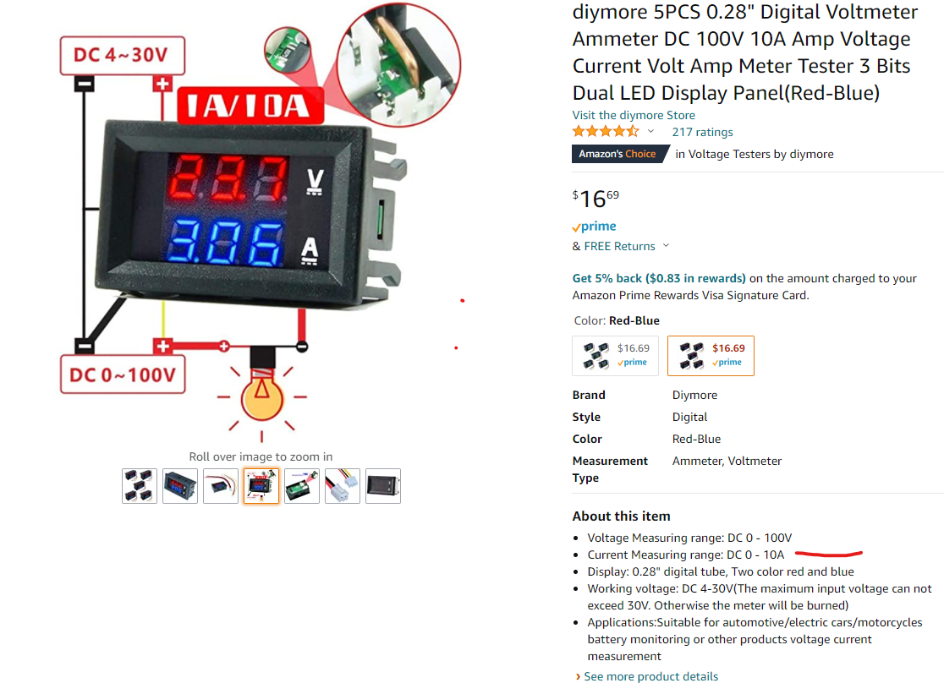
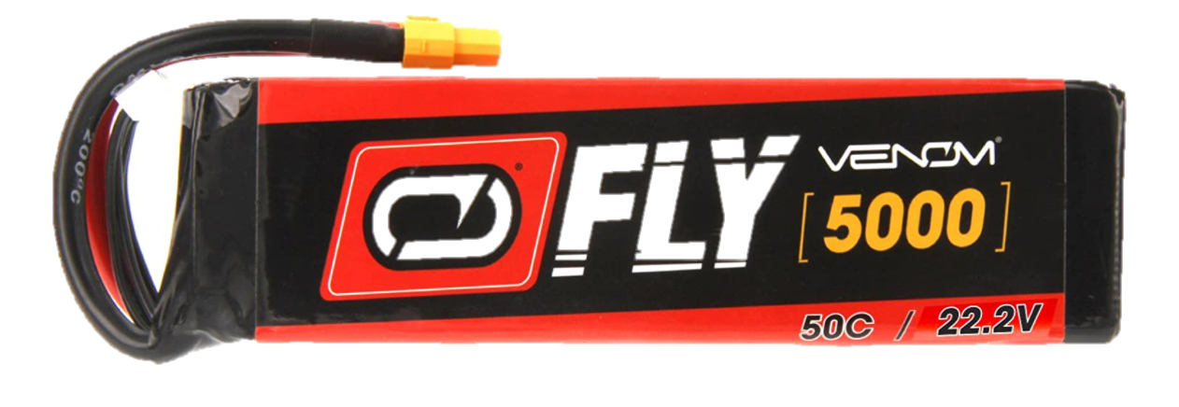
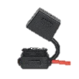
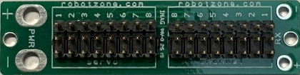
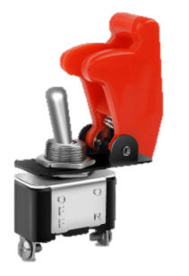
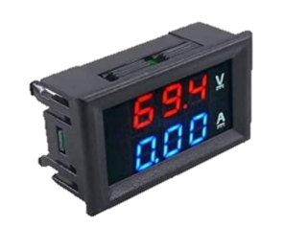
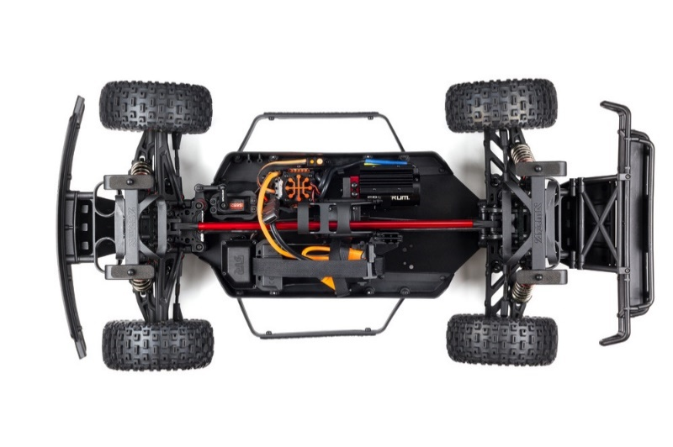
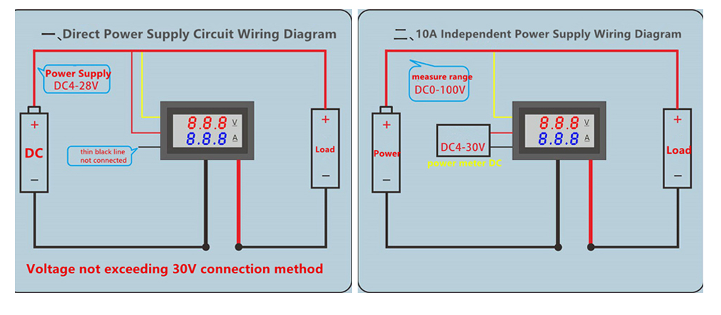
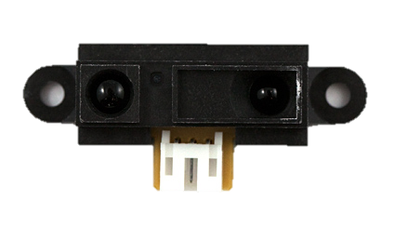
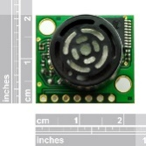
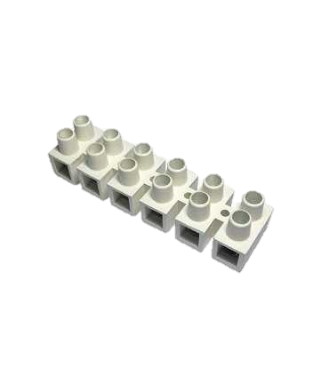
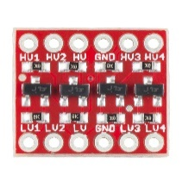


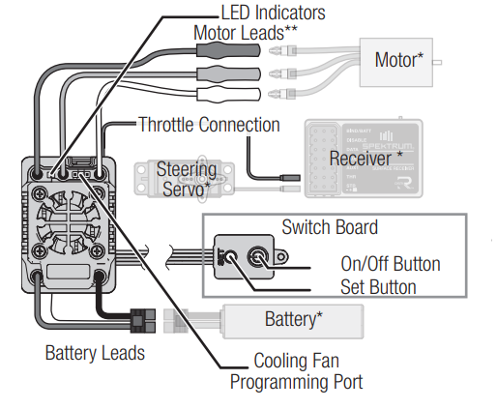
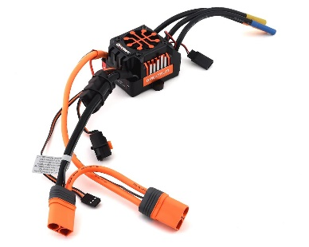
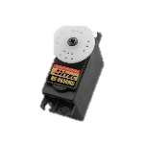
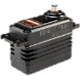
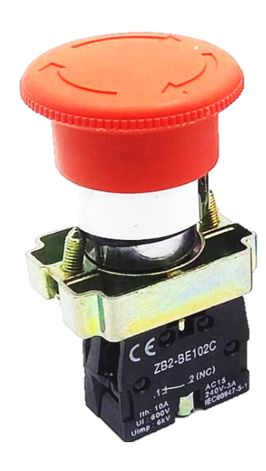
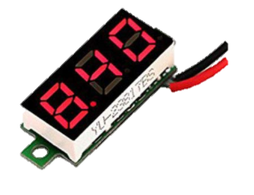
FunRobo-Mojave 2022-RevE Wiring Diagram
Joystick
SparkFun GPS NEO-M8U
GNSS Multi-Band Magnetic Mount Antenna - 5m (SMA)
I GPS-15192
The NUC back panel DC connector is compatible with a 5.5 mm/OD (outer diameter) and 2.5 mm/ID (inner diameter) plug, where the inner contact is +12-19 (±10%) V DC and the shell is GND. The maximum current rating is 10 A.).
19VDC 5A
supply
Hokuyo Lidar
USB COM4
5vdc 0.5A
WiFI
Laptop OCU
Nuc-i7
SVPRO USB Webcam with Zoom Lens 5-50mm Manual Focus Webcam,8MP High Resolution Web Camera
USB COM1
USB COM3
5vdc 0.22A
USB COM2
uxcell Power Converter
DC24V to DC19V 5A 95W
Pololu 5V, 1A
Step-Down Voltage Regulator
Arduino Nano 33 BLE
Shore power 19VDC
Wall or battery, not both!
19vDC
100% load: 49W
2.6A
HiLetgo Nano V3.0
Controller Terminal Adapter
The microcontroller on the Arduino Nano 33 BLE runs at 3.3V,
which means that you must never apply more than 3.3V to its Digital and Analog pins.
Arduino Nano 33 BLE
100mA
Pan Axis
Servo city
DDP155 Base Pan
19VDC 5A
Fuse
3.3V
A0=S8
A7=S7
A6=IR6
A5=IR5
A4= IR4
A3= IR3
A2= IR2
A1 = IR1
Switch
diymore Digital
Voltmeter Ammeter
Ultrasonic Range Finder
LV-MaxSonar-EZ4
3.1mA
IR1
Venom Fly 50C 6S 5000mAh 22.2V
LiPo Battery with UNI 2.0 Plug (XT60)
240ma
ARRMA-Mojave ARA7604V2T1
5vDC
Servo Power Board (assembled with full pins)
SC71353
1
2
3
4
5
V+
GND
IR2
IR6
S8
Mother
Ground
1
2
3
4
5
V+
GND
S7
S8
SparkFun
Logic Level Converter
- Bi-Directional
BOB-12009 ROHS
S7
IR6
IR3
IR5
PWM 6 Pan
IR5*
PWM 5 Steering
Make Body:
White 3mm 1/8" Sintra 24" x 36"
Mounting Boards – 2 sheets
PWM 3 Velocity
IR4
5V
IR4*
PWM3
Servo Power Board (assembled with full pins)
SC71353
*May not
Be able to use 4 and 5
And Nano Heading i2c
At same time.
They share output pins
IR3
Spektrum Firma
150a esc
PWM5
Servo City
2000 Series Dual Mode Servo
Reference only
E-Stop
Switch
Camera Pan
Servo Motor
IR2
spektrum firma 150a esc
Spectrum
Steering Motor
Fuse
IR1
Sharp GP2Y0A02YK0F
IR Range Sensor
-20 cm to 150 cm
40mA
Venom Fly 50C 6S 5000mAh 22.2V
LiPo Battery with UNI 2.0 Plug (XT60)
Diymore LED Display
24V Voltage Meter Detector

Slide 2
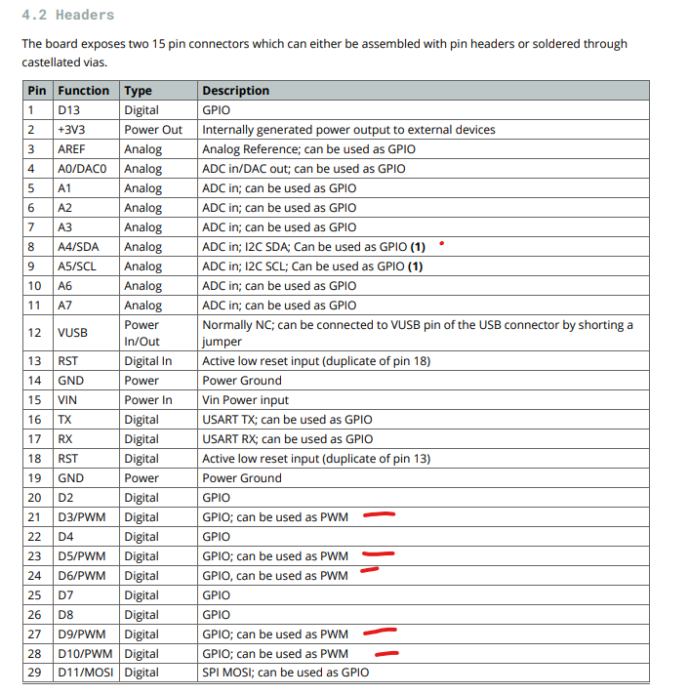
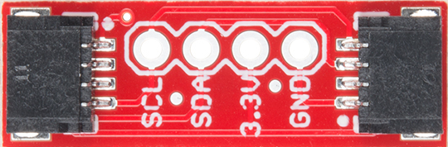
Joystick
Joystick
SparkFun Qwiic Adapter
In stock DEV-14495

